Slide 1
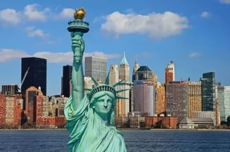
My adventure in New York

Slide 2
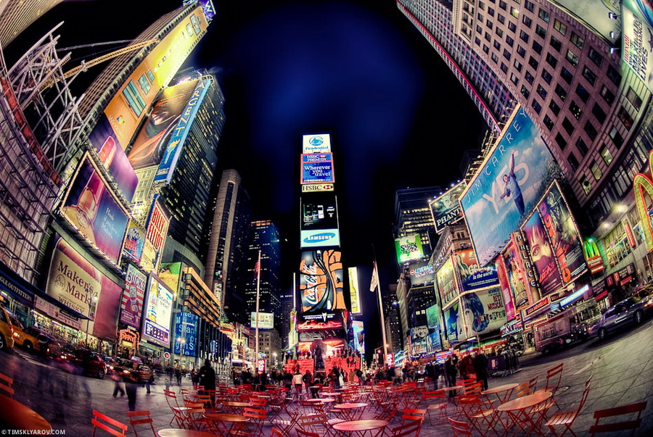
Hi! Today l came to New York. New York to be in the United States of America.

Slide 3
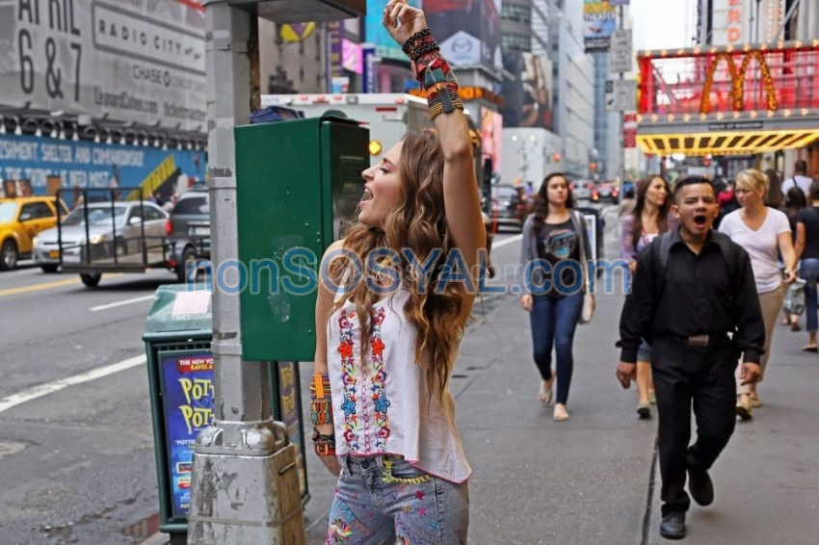
Population today is 8 405 837

Slide 4
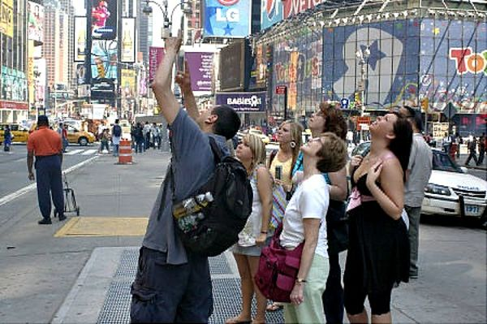
In New York constantly sore neck. Because you have to tilt your head .

Slide 5
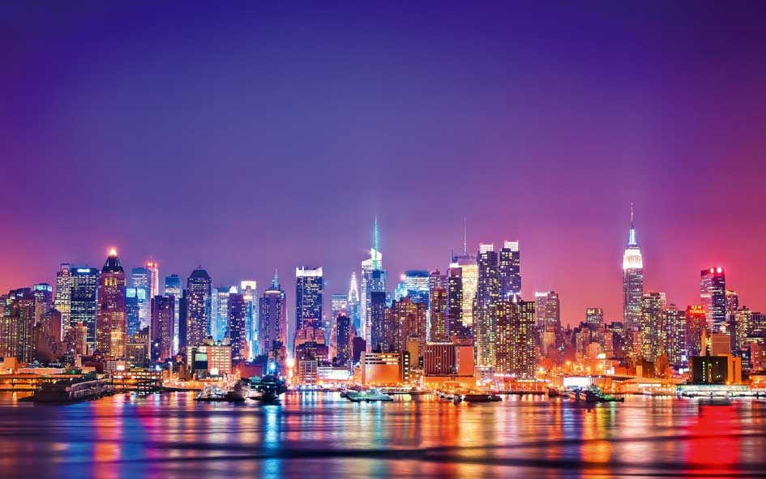
Tourist from an indigenous person can be distinguished by head cocked upwards

Slide 6
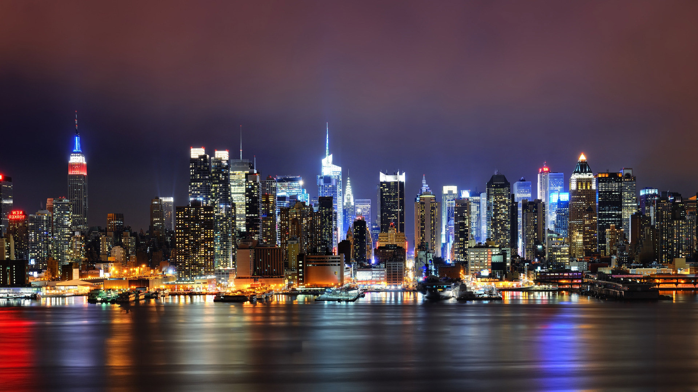
New York city skyline.

Slide 7
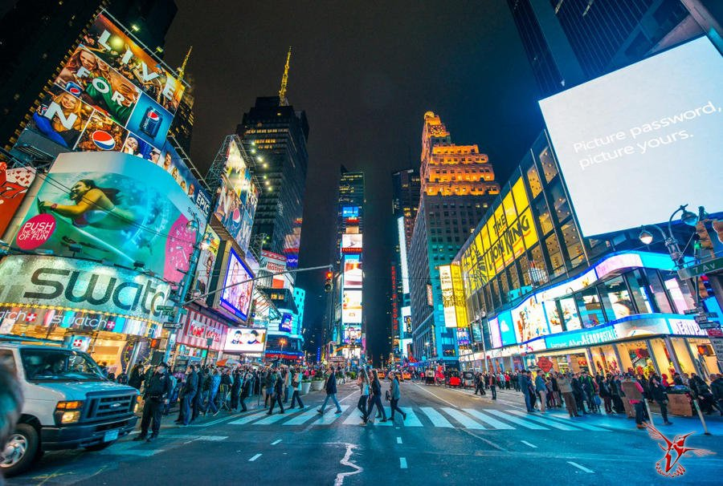
the tallest building is 449 meters at a height of 340 meters, you can admire stunning views of new York.

Slide 8
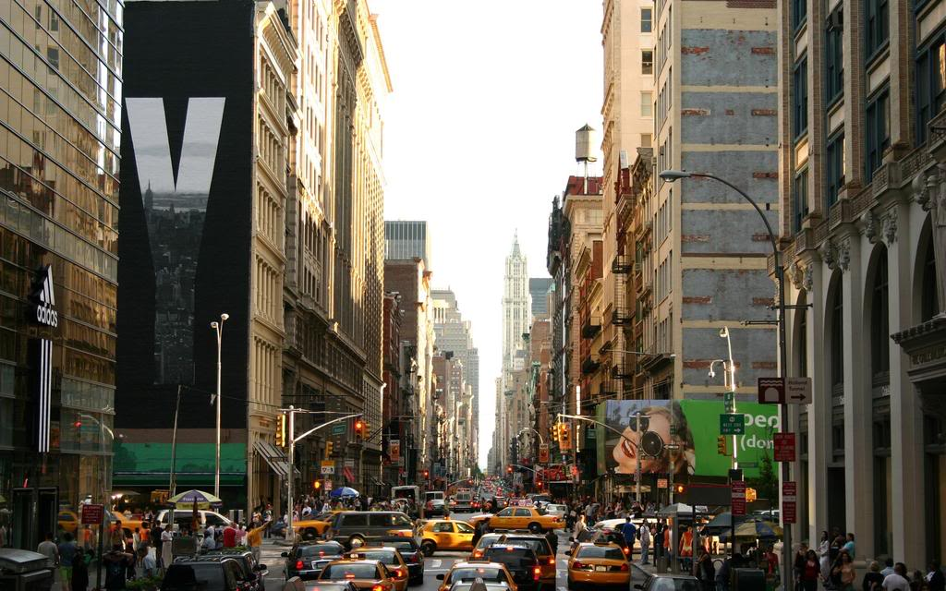
The entrance ticket for adults costs $ 16

Slide 9
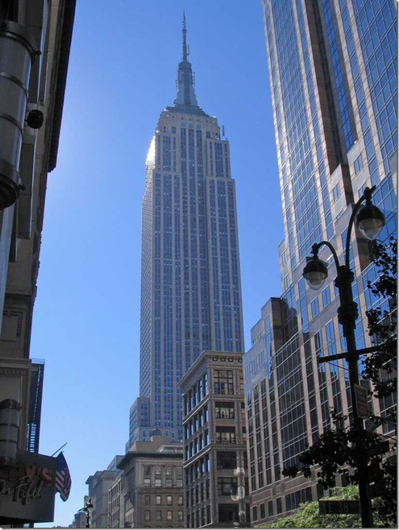
And although 73 in the building Elevator ,had to stand in line. People do not protalknutsya .

