Slide 1
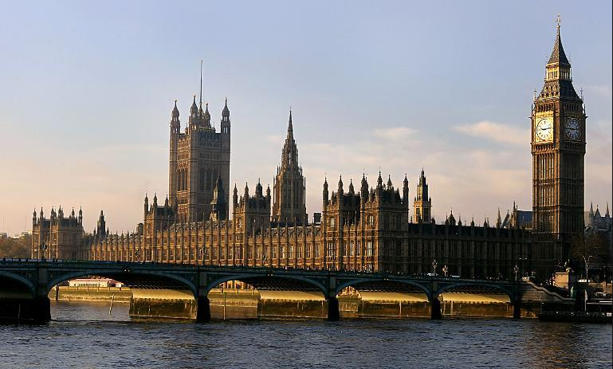
British parliament

Slide 2
Elizabeth II is the reigning monarch of great Britain
Elizabeth II - the oldest British (English) monarch in history. She is currently ranked second in the history of the duration of stay in the British throne (after Queen Victoria) and also second in the world for the duration of your stay as head of state among the incumbent President (after King Bhumibol Adulyadej of Thailand). Is also the older women in the world - the incumbent president.

Slide 3
Britain is administered from the Palace of Westminster in London. This is also known as the Houses of Parliament. Parliament is made up of two chambers — the House of Commons and the House of Lords.

Slide 4
The members of the House of Lords are not elected: they qualify to sit in the House because they are bishops of the Church of England, aristocrats who have inherited their seats from their fathers, people with titles. There has been talk of reform in this century because many Britons think that this system is undemocratic. The House of Commons, by contrast, has 650 seats which are occupied by Members of Parliament (MPs) who are elected by the British public. The United Kingdom is divided into constituencies, each of which has an elected MP in the House of Commons. Each of the major political parties appoints a representative (candidate) to compete for each seat. Smaller parties may have a candidate in only a few constituencies. There may be five or more parties, fighting for one seat, but only one person — the candidate who gets the greatest number of votes — can win. Some parties win a lot of seats and some win very few, or none at all. The Queen, who is the Head of State, opens and closes Parliament. All new laws are debated (discussed) by MPs in the Commons, then debated in the Lords, and finally signed by the Queen.

