Slide 1
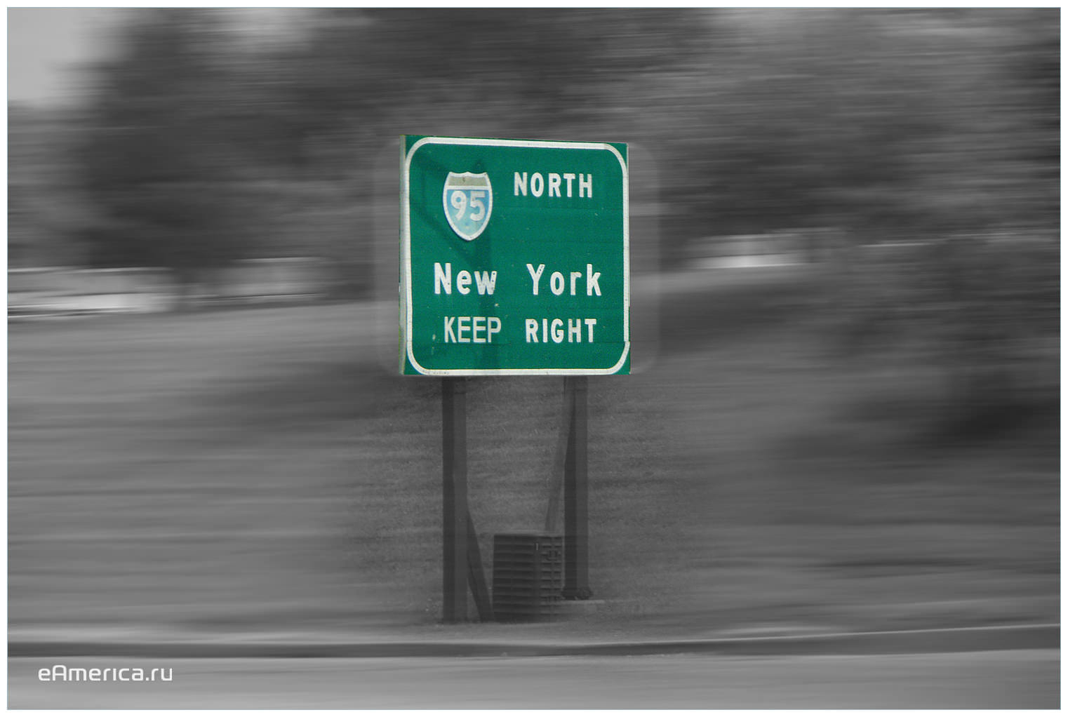
Оne day in New York

Slide 2
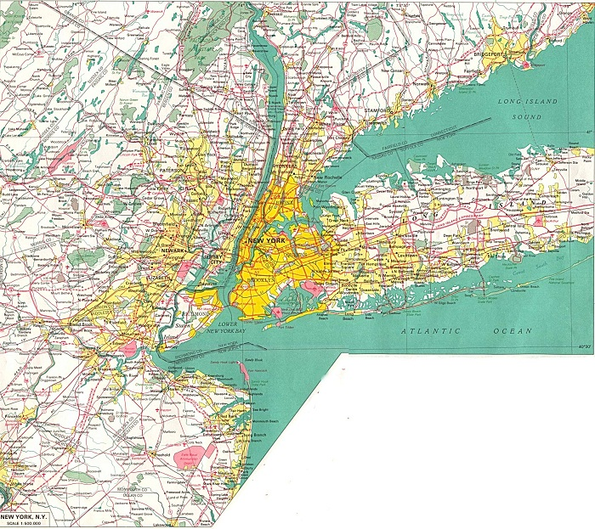
The population is 8,405,837 people, of agglomeration - 20630000

Slide 3
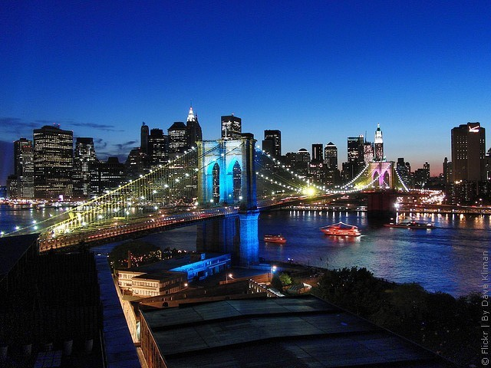
Brooklyn Bridge in New York City is the oldest suspension bridge in the United States. He passes over the East River and connects the two districts - Manhattan and Brooklyn.
The Brooklyn Bridge

Slide 4
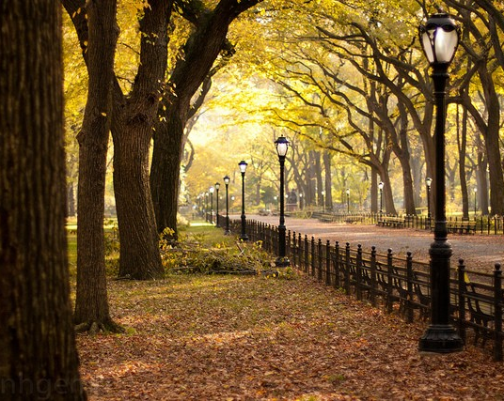
Each year, Central Park in New York, attended by about 25 million people, it is the most visited park in the United States
Central Park in New York,

Slide 5
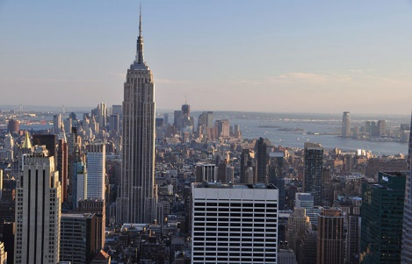
Подготовила Заводова Дарья

