Slide 1
retro style
Retro - quite abstract art-historical term used to describe the different categories of antiques, with some cultural and / or material value, and, as a rule, not often found in modern everyday life with its deliberate practicality and the desire to get rid of "unnecessary" parts

Slide 2
Elements of retro-style dress 20-30s
Today, these images seem to us the essence of femininity, and
the image in the style of the 20s and today is extremely popular.
It is characterized by:
Cloche hat-in the form of a bell or the fitting hat made of felt with
the decor side
Neckpiece made of natural fur
Dress with a low waistline
Shoes kabluke- "a drink" with rounded toe
Hair styling waves called "ondulyatsiya«
A cigarette in a long mouthpiece

Slide 3
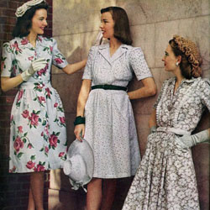
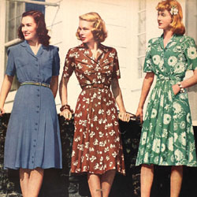
,,,

Slide 4
40-ies
Due to the fact that for a long time there was a war, the fashion industry before the end of the 40s was in decline. Fashions of those years distinguished by brevity and restraint. However, there are recognizable features that eloquently remind us of an era:
The fitted jacket or a jacket with big shoulder pads
Krepdeshinovoe dress with a V-neck
Classic hat with the fields
Hairdo "roller«

Slide 5
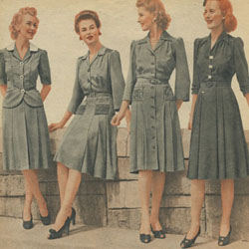
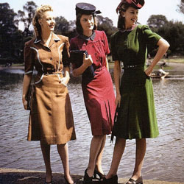

Slide 6
50-ies
In the 50 years of Christian Dior introduced the fashionable
new look: femininity, elegant and refined image. His most
recognizable features:
Tightened at the waist dress with a full skirt
The sloping shoulder line
Long gloves
Elegant hats
Shoes with "stiletto" narrow nose

Slide 7
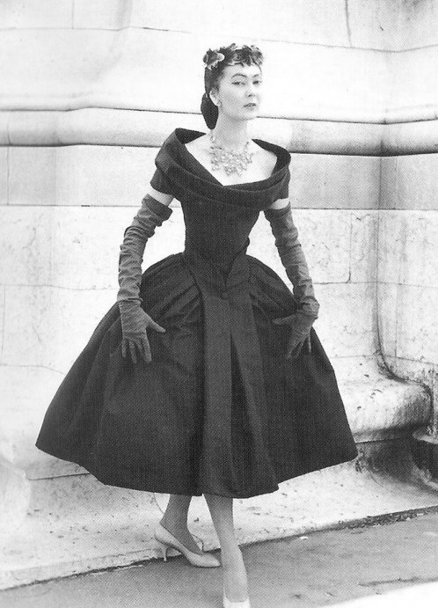
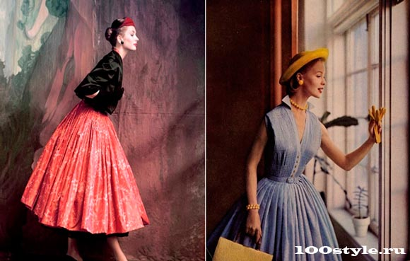

Slide 8
Elements of retro style clothes 60's
Сalled sexual revolution that sweeps away all inhibitions. Nothing
new after this era in fashion could not appear, everything else is just
versions and new technologies. Features of this fashion variety:
Mini skirt
Clothing with a sleeve "three quarters«
Shortened-fitting trousers
Updo with a bouffant
Headbands, turbans, and shawls
Large sunglasses in a stylish frame

Slide 9
Elements of retro-style 70-ies
In the 70-ies of the in Vogue style "hippie", and fashion gave us
such familiar things:
The bell bottoms
Shoes on the platform
Loose tunic or “vest”
Form-fitting dress to the floor

Slide 10
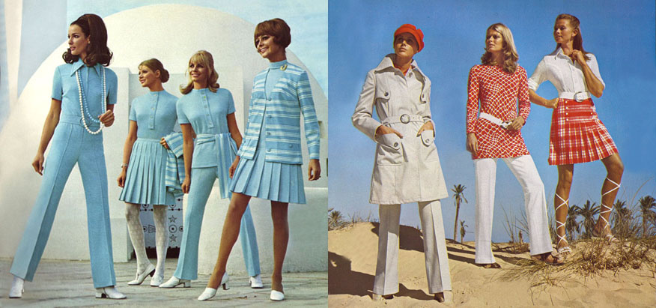

Slide 11
famous fashion designers in a retro style
Christian Dior
Jean-Paul Gaultier
Coco Chanel
Ralph Lauren
Karl Lagerfeld

Slide 12
Performed:
student in grade 9
MOU “convent school”
Zavodova Xenia

