Slide 1
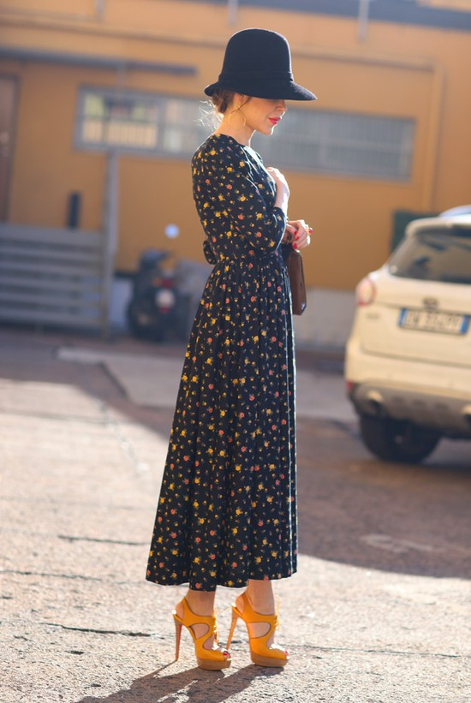
Vintage style

Slide 2
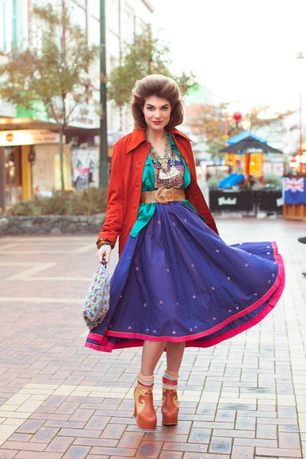
Vintage" in fashion and design generally implies the original thing the previous generation (i.e. under 30), which is clearly seen "rage" and rush style since its inception. That is why the passion for vintage you need to constantly refer to the history of fashion of different decades of the twentieth century. Despite the fact that the demand for vintage clothing has existed since the early 1950's, vintage style appeared, and then came into Vogue in Nacala-ies. Increased public interest in this new direction, are now part of the Western mass culture, was caused largely by a passion for vintage clothing's top models and celebrities such as Julia Roberts, Renee Zellweger, Chloe sevigny,Tatiana Sorokko, Kate moss and Dita von Teese.[1][2] Final confirmation of vintage clothing as a legitimate phenomenon of fashion has been the emergence of First lady Obama Schemichel the evening toilet of the 1950s, American fashion designer Norman Norell (Norman Norell) at the Christmas in Washington concert in December 2010

Slide 3
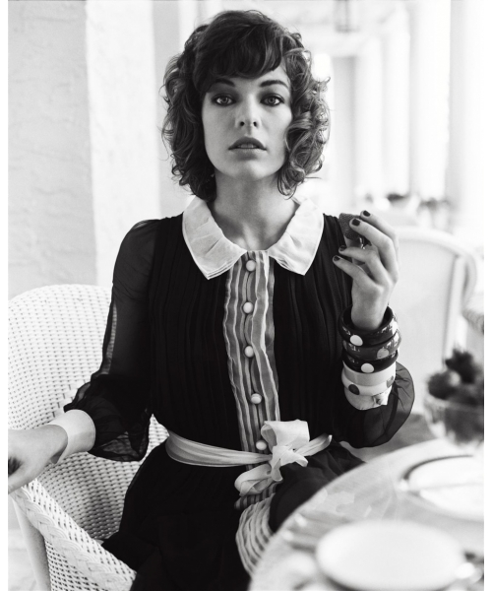
Criteria
The main criterion is the age of vintage object - it should be 30 to 60 years.
The clothes that you created in the last 15 years is considered to be a modern,
over 60 years - antiques. Some fashion designers [who?] Refer to a vintage clothing created before the 60s.
the last century,
and things started in the later period, considered to retro. Traditionally, classification of vintage items divided for decades .
Another criterion reckoning things in the category of vintage style is a reflection of the inherent specific period:
Vintage items must express the fashion trends of their time.
Vintage items and clothing from older collections of famous designers of the XX century are collectible.

Slide 4
Interesting facts
• In March, in Helsinki (Finland) hosts an annual festival of vintage.
Venue - the cultural center Kaapeli
• That the City of New York (USA) - a city in which regularly takes a huge amount of vintage markets.
Among the most popular vintage items: jewelry and other jewelry, furniture, books.
• Every Sunday in Berlin (Germany) in the Mauerpark, at Gleimstraße 55,
held the largest market of the vintage.

Slide 5
Performed:
student in grade 9 MOU "monastery school"
Zavodova Daria

