Slide 1
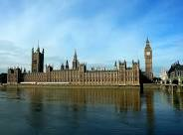
The Houses of Parliament

Slide 2
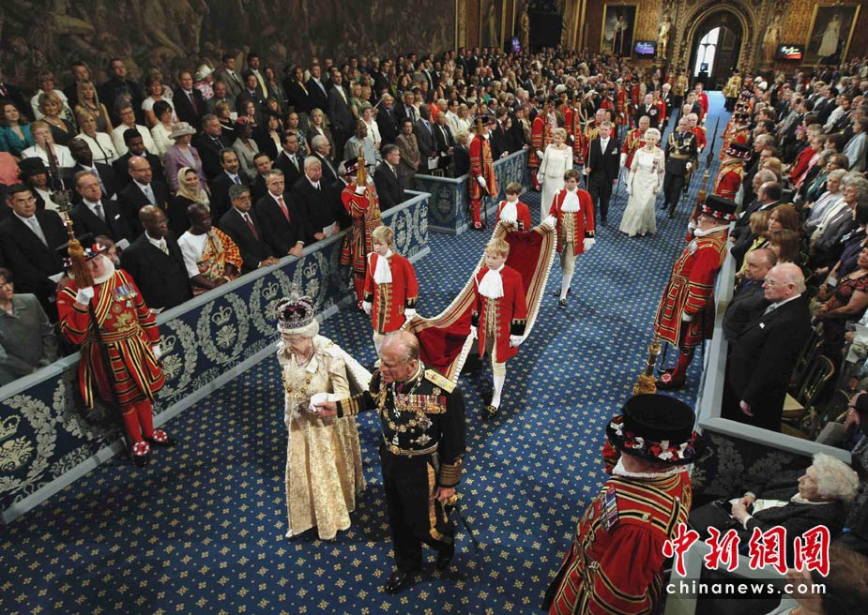
The Parliament of the United Kingdom of Great Britain and Northern Ireland (Eng. Parliament of the United Kingdom of Great Britain and Northern Ireland) is the supreme legislative body in the United Kingdom and the Royal Overseas Teritories.It is not led by the British monarch, but he is part of it. Bicameral parliament, includes the upper house, called the House of Lords, and a lower house called the House of Commons. The House of Lords is not selected, it includes the Lords Spiritual (the higher clergy of the Anglican Church), the secular lords (peers) and the Lords of Appeal (Eng. List of Lords of Appeal), many of whom have inherited their power. The House of Commons, on the contrary, the democratically elected House. The House of Lords and House of Commons are going in different rooms of the palace of Westminster in London. According to custom, all the ministers, including the prime minister, chosen solely from Parliament.

